Slide 1


.NET MAUI Part 5: CollectionView & Beyond
James Montemagno
Principal Lead PM – Developer Community, Microsoft
@JamesMontemagno
/JamesMontemagno

Slide 2
.NET MAUI Part 5: CollectionView & Beyond
<Name>
<Role>
@<Twitter>
/<YouTube>

Slide 3
CollectionView
CollectionView is a view for presenting lists of data using different layout specifications. It aims to provide a more flexible, and performant alternative to ListView.

Slide 4
CollectionView vs ListView
CollectionView has a flexible layout model, which allows data to be presented vertically or horizontally, in a list or a grid.
CollectionView supports single and multiple selection.
CollectionView has no concept of cells. Instead, a data template is used to define the appearance of each item of data in the list.
CollectionView automatically utilizes the virtualization provided by the underlying native controls.
CollectionView reduces the API surface of ListView. Many properties and events from ListView are not present in CollectionView.
CollectionView does not include built-in separators.
CollectionView will throw an exception if its ItemsSource is updated off the UI thread.

Slide 5


Layouts
List
Grids
<CollectionView.ItemsLayout>
<GridItemsLayout Orientation="Horizontal" Span="3"/>
</CollectionView.ItemsLayout>

Slide 6
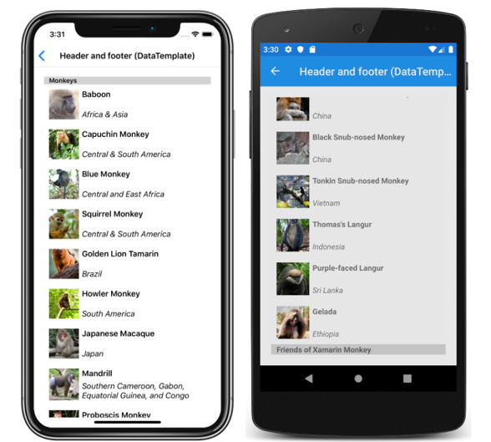
Headers & Footers

Slide 7

EmptyView
<CollectionView.EmptyView>
<StackLayout Padding="100">
<Image
HorizontalOptions="CenterAndExpand"
Source="nodata.png"
VerticalOptions="CenterAndExpand" />
</StackLayout>
</CollectionView.EmptyView>

Slide 8
Grouping
public class PodcastGroup : List<Podcast>
{
public string Name { get; private set; }
public PodcastGroup(string name, List<Podcast> podcasts)
: base(podcasts)
{
Name = name;
}
}
List<PodcastGroup> Podcasts { get; private set; }

Slide 9
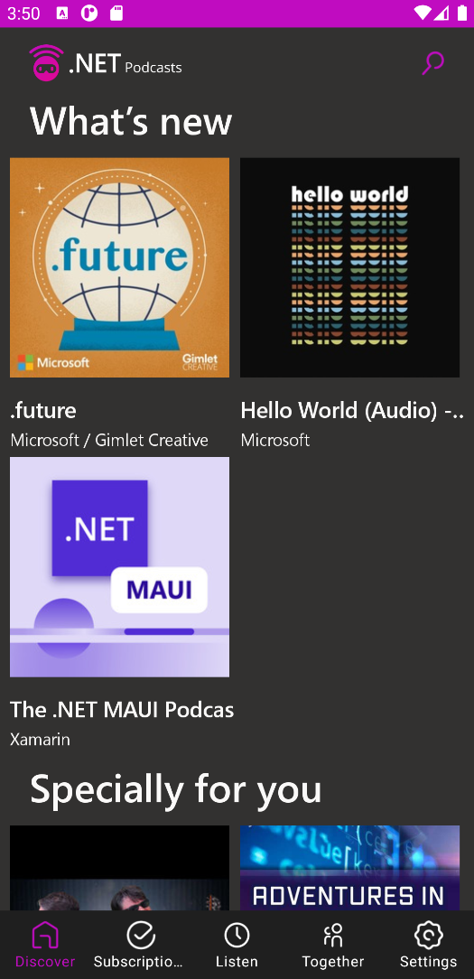
Grouping
<CollectionView ItemsSource="{Binding Podcasts}"
IsGrouped="true">
<CollectionView.GroupHeaderTemplate>
<DataTemplate>
<Label Text="{Binding Name}"
BackgroundColor="LightGray"
FontSize="Large"
FontAttributes="Bold" />
</DataTemplate>
</CollectionView.GroupHeaderTemplate>
</CollectionView>

Slide 10
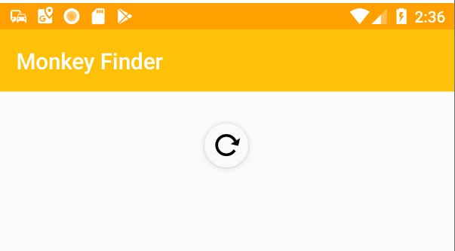
Pull-to-Refresh

Slide 11
public class MyViewModel : ObservableObject {
[ObservableProperty] private bool isBusy;
[ObservableProperty] private bool isRefreshing;
[ICommand] async Task Refresh() { if (IsBusy) return; IsBusy = true;
//do stuff IsRefreshing = false;
IsBusy = true; } }

Slide 12
ListView Support
<ListView x:Name="listView" ItemsSource="{Binding Items}" HasUnevenRows="True" IsPullToRefreshEnabled="True" RefreshCommand="{Binding RefreshCommand}" IsRefreshing="{Binding IsBusy}">

Slide 13
ListView API
//Enable/Disable all pull to refresh public bool IsPullToRefreshEnabled { get; set; } = false;
//Is the spinner currently shown public bool IsRefreshing { get; set; } = false;
//The method/command to trigger when pulled public ICommand RefreshCommand { get; set; } = null;
//Manual Events to trigger/subscribe public void BeginRefresh (); public void EndRefresh ();
public event EventHandler Refreshing;

Slide 14
RefreshView
<RefreshView Command="{Binding RefreshCommand}" IsRefreshing="{Binding IsRefreshing}">
<CollectionView ItemsSource="{Binding Items}">
…
</CollectionView>
</RefreshView>

Slide 15
RefreshView API
//Enable/Disable all pull to refresh public bool IsEnabled { get; set; } = false;
//Is the spinner currently shown public bool IsRefreshing { get; set; } = false;
//The method/command to trigger when pulled public ICommand Command { get; set; } = null;
//Manual Events to /subscribe public event EventHandler Refreshing;

Slide 16
Optimize CollectionView
<Name>
<Title>
<email>
<website>
@<twitter>
/<YouTube>

Slide 17

Optimize
CollectionView
Weekly development podcast
mergeconflict.fm
James
Montemagno
Principal Lead PM – Developer Community, Microsoft
motz@microsoft.com
montemagno.com
@JamesMontemagno
/JamesMontemagno

